Slide 1
Importance Of SSLC Complete Presentation
Tips for a simpler way to success ….

Slide 2
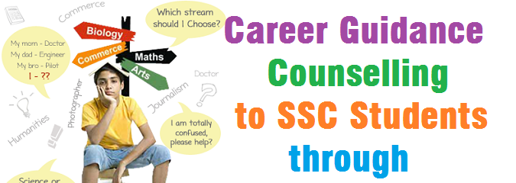
By MR.A.M.K SIDDIQU M.A , MBA , M.PHIL (P.HD)

Slide 3
What is education?
The process of receiving or giving systematic instruction, especially at a …
1
School
2
College
3
University

Slide 4
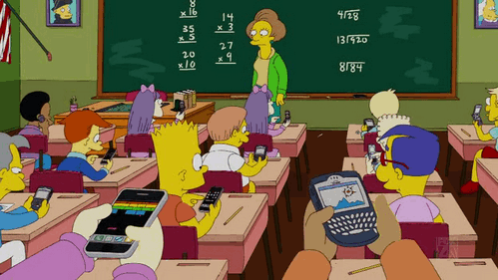
Education in 21st century in developed countries

Slide 5
Psychology of Students

Slide 6
What after 10th ?
Notes:
In Slide Show mode, click the arrows to visit links.

Slide 7
Streams
Arts Stream: – This stream has a variety of Subjects which offers exciting opportunities after 12th. in this stream you can chose subject History, Geography, Political Science, Home Science, Psychology, English, Hindi, philosophy etc. English and Hindi are two compulsory subjects which you have to study with optional subjects. If you are interested in social services, human rights, history, geography than we advise you to choose this Stream. You also can go for courses of mass media and journalism after 12th.
Science Stream: – This stream offers 5 subjects English, Hindi, Physics, chemistry, mathematics/Bio-logy and all subjects are compulsory except Mathematics and Biology. You can choose one of these two. If want to make your carrier in medical field than you should chose Biology because this offers variety of courses after 12th like MBBS, BDS, BHMS, Pharmacy etc.
If you are interested in some technical field than you should chose Mathematics as 5th subject because after 12th you can go for various engineering courses like engineering in computer, electronic, civil and in architectural courses etc.
Industrial Training Institute: – Students who want to get admissions in technical courses but they do not have enough funds to do so than they should go for this 1 year course called ITI. After this they can get admissions in polytechnic diploma courses.
Polytechnic Diploma: – Students who want to get admission in technical courses should take admission in polytechnic diploma. It is a 3 year course. After this course they can get admission directly in 2nd year of B.Tech.
Certification courses: – Candidates can get admissions in certificate courses after class 10th like networking; tally etc. but these courses have less job opportunity. These courses have time duration of 6 months 1 year according to preference of student.

Slide 8
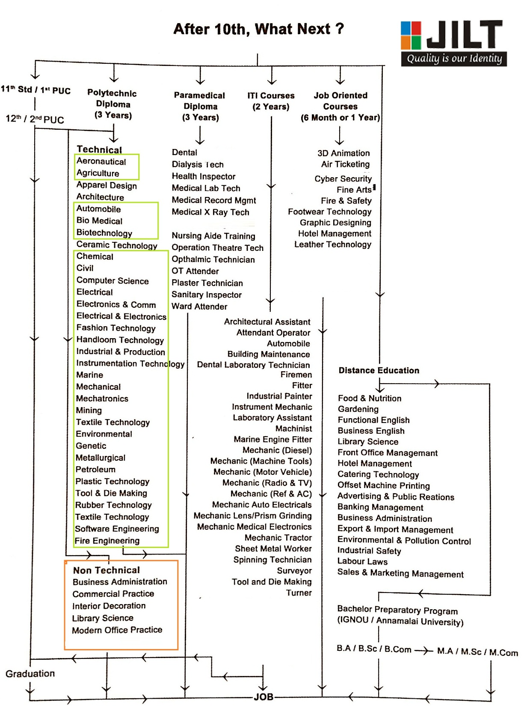

Slide 10
Thanks
www.jilt.in
info@jilt.co.in
+91-7036373199
Mr.A.M.K SIDDIQUI
CELL : +91-7396719556

